Slide 1
Oregon VE Models Installation Guide
Using the VE-Dev and VE-Extras repositories to install and use the VisionEval model
May 2024

Slide 2
VE_Dev & VE_Extras Repos
ODOT

Slide 3
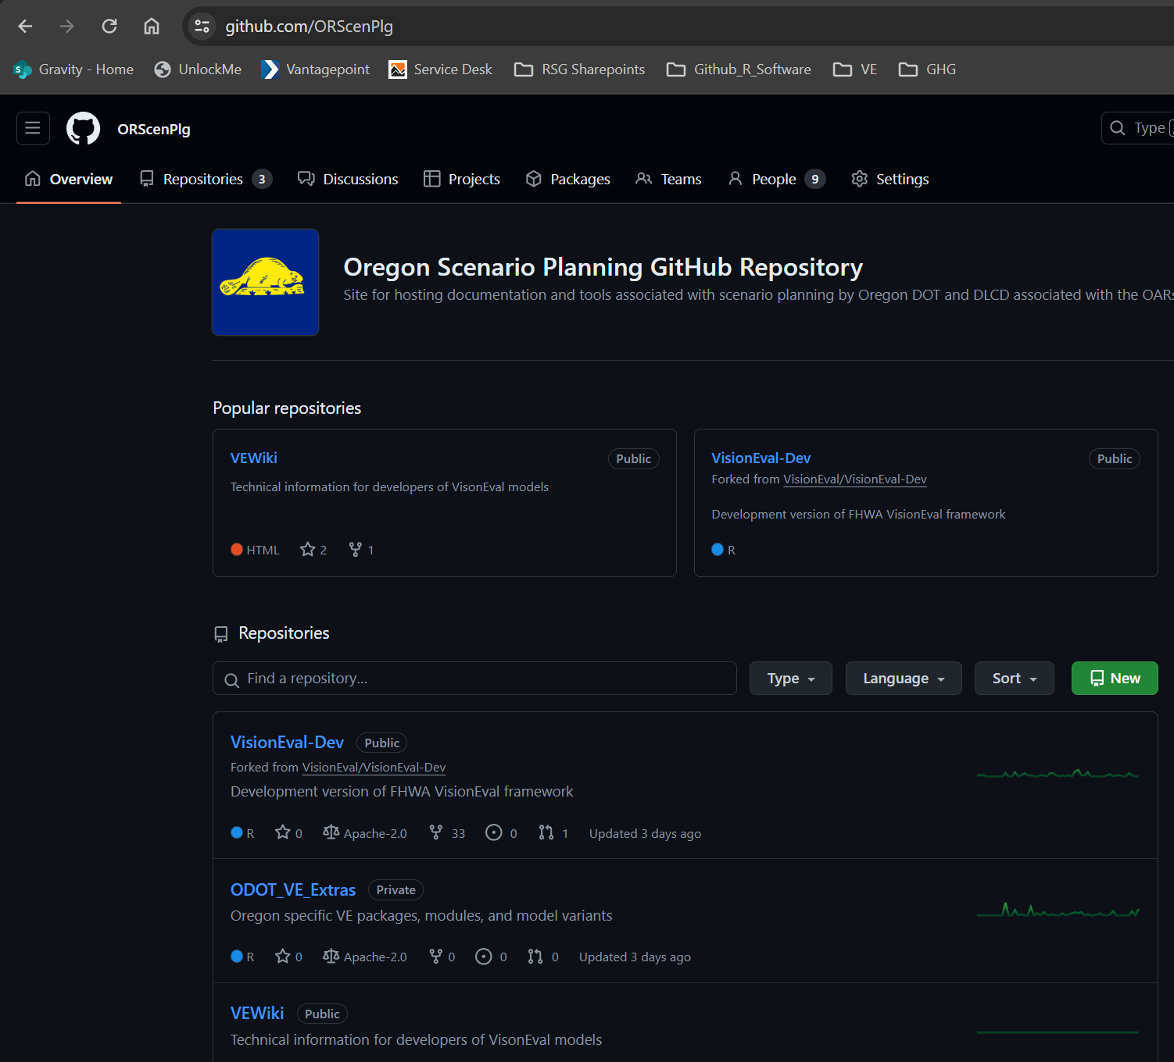
Oregon Scenario Planning GitHub Organization
https://github.com/ORScenPlg
Repos:
VEWiki: source for the Oregon Scenario Planning guidance on the web. GitPages: https://orscenplg.github.io/VEWiki/
VisionEval-Dev:
Branch: ODOT
Is a branch forked from the FHWA VisionEval-Dev repo that can stay up to date with the latest changes at the FHWA version of VE.
It includes:
Oregon PUMS for VESimHouseholds
ODOT_VE_Extras: Oregon specific packages and model variants.

Slide 4
VisionEval-Dev & VE_Extras Relationship
1
After a Built runtime environment has been installed. The folder ve-lib holds all the installed packages used during runtime.
…\built\visioneval\4.4.0\ve-lib
The ve-lib from the initial install of VisionEval-Dev includes all the core packages.
VEHouseholdTravel
VEHouseholdVehicles
VELandUse
VEPowertrainsAndFuels
VESimHouseholds
…
2
VE_Extras repo stores all the packages which can be installed to the built runtime ve-lib folder.
This allows for Oregon specific models, packages, and variants to be replace the generic packages.
VEHouseholdVehiclesDL
VEHouseholdVehiclesIncCap
VELandUseDL
VEPowertrainsAndFuelsAP2022
VEPowertrainsAndFuelsSTS
VESimHouseholdsSKATS
….

Slide 5
Core VE Models
ODOT

Slide 6
Step 1: Clone the VisionEval-Dev and ODOT_VE_Extras repositories
Use the RSG Github page to clone both the VisionEval-Dev and ODOT_VE_Extras repositories using your Git-compatible software of choice
VisionEval-Dev link for cloning: https://github.com/ORScenPlg/VisionEval-Dev.git
ODOT_VE_Extras link for cloning: https://github.com/ORScenPlg/ODOT_VE_Extras.git
Software options:
Gitbash: https://gitforwindows.org/
Github Desktop: https://desktop.github.com/
Tortoise Git: https://tortoisegit.org/
Preferred R IDE:
RStudio: https://posit.co/download/rstudio-desktop/

Slide 7
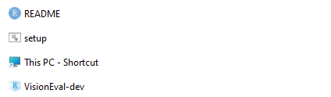
Step 2: Build the VisionEval model
Open the VisionEval-Dev folder on your local machine and open the VisionEval-Dev R project
Build the model by entering “ve.build()”. Depending on the speed of the machine, this will likely take several hours.
Once complete, open the ODOT_VE_Extras folder on your local machine. Open the “setup” batch file.
ODOT VE Extras
This Repo stores ODOT specific VisionEval files such as packages for model runs, model variants (to reflect reference conditions as well as future STS and preferred scenarios, etc.), and any custom models for ODOT or Oregon MPOs (Salem, Central Lane).
Specifically, the synthetic population for Salem is created using ACS PUMS data in the VESimHouseholdsSKATS package, or customized for Oregon for VE-State using the VESimHouseholds package from the ODOT branch of VisionEval-Dev.
Powertrain and Fuels information are held in the VEPowertrainsAndFuelsAP2022 and VEPowertransAndFuelsSTS.
Teleworking and sensitivity to built land use form are both accounted for in the VETravelDemandWFH package.

Slide 8
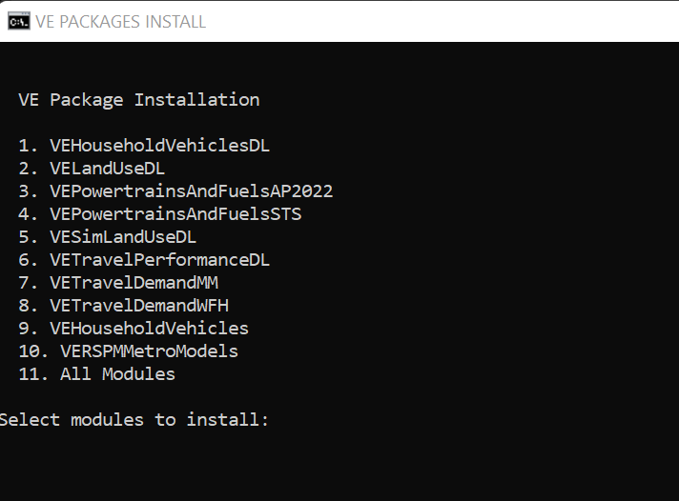
Step 3: Install packages to the VE Library
Enter the following in the command window for the setup file:
The user indicates whether they want to set the R and VE library. Enter “y” and press enter.
The path to provide for R file should be the R installation directory for the R version you have used to install and build the VisionEval model (ex. “C:\Program Files\R\R-4.2.1”).
The path to the VE library should be the “ve-lib” folder of the built model (ex. “C:\OrScen_VisionEval-Dev\built\visioneval\4.2.1\ve-lib”)
A prompt will appear to choose which VE packages to install. You may choose an individual package by entering the corresponding number and pressing enter, or install all by choosing the number for “All Modules.”
Verify the packages have built in the VE Library path.
Note: the Batch file may quit unexpectedly without installing all the packages. This often occurs if a package required a dependency that hasn't been installed. For example, the package "sn" is required.
There is a package by package process that may need to be followed if the batch file process fails to install all the necessary packages. See the next slide step 4.

Slide 9
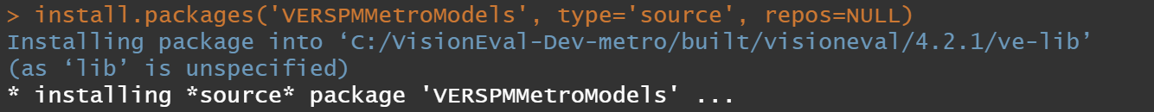
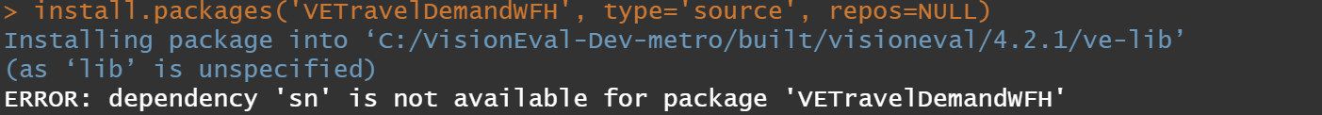
Step 4: Troubleshooting install issues
If the package has not built in the VE Library or displays an error, additional dependency installations may be required.
Open the ODOT_VE_Extras folder and open the VisionEval-dev R project.
Use the “install.packages” command to install the desired VE modules (the additional commands “type” and “repos” are required as pictured).
Install attempts may display a specific error or R packages that need to be installed prior to installing the VE module:
In this case, the user needs to enter install.packages(“sn”) to install the sn package prior to installing VETravelDemandWFH.
Using this method will install the packages directly into the VE Library of the built runtime.
Replace the package name with the one you want to install from VE_Extras

Slide 10
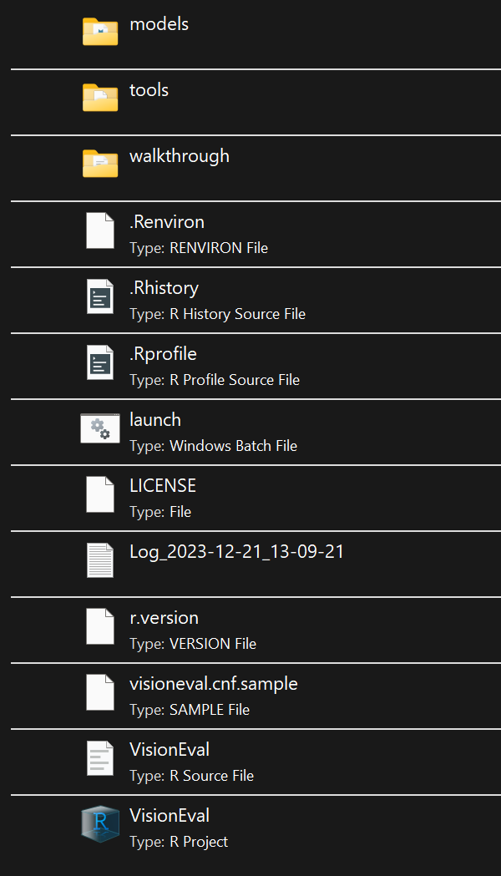
Step 5: Install and run a VE Model
Open the R project VisionEval in “C:\VisionEval-Dev-metro\built\visioneval\4.2.1\runtime”
Open "C:\OrScen_VisionEval-Dev\built\visioneval\4.2.1\runtime\VisionEval.Rproj"
R Studio should open to the Runtime environment for VisionEval.

Slide 11
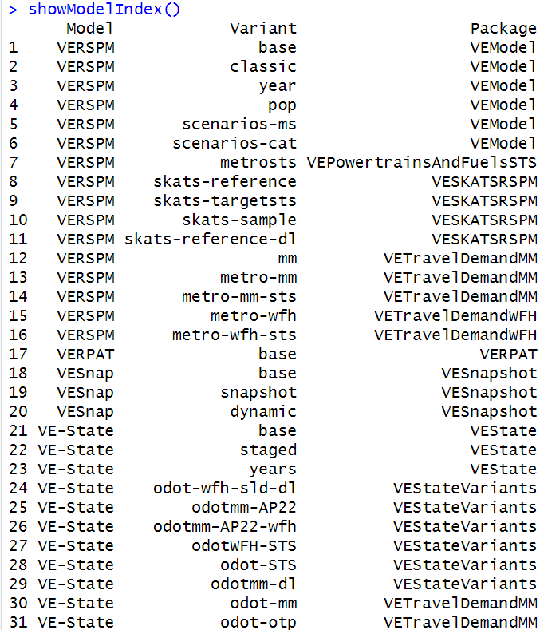
Step 5: Install and run a VE Model
Variants are specific VisionEval models with unique run scripts, input files, and packages that are called during the run_model.R script.
Install VERSPM Metro variant
To view the available VE variants enter showModelIndex().
Oregon VE-State models are found in the VEStateVariants package
Odot-wfh-sld-dl
Odotmm-AP22
Odotmm-ap22-wfh
odotWFH-STS
Odot-STS
Odotmm-dl
There are the SKATS RSPM variants as well shown in the VESKATSRSPM package
Select a variant and install using the following installModel command structure:
installModel(“VE-State”, “odot-wfh-sld-dl”), and enter “y” when prompted

Slide 12
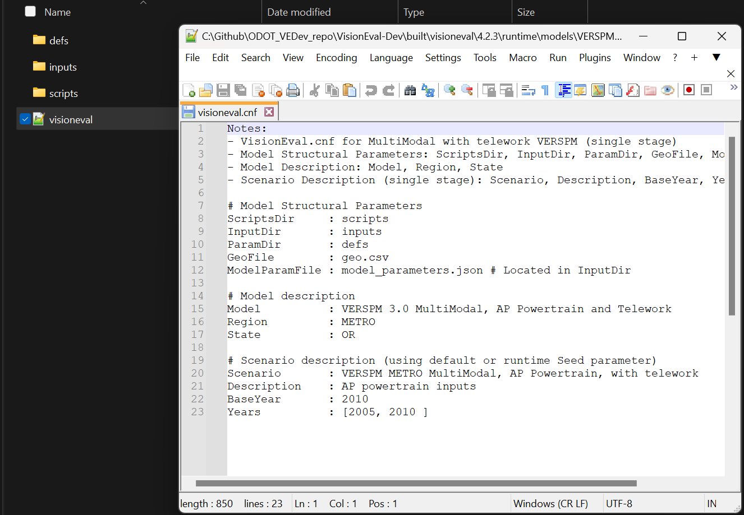
Step 5 (con’t): Install and run a VE Model
Set the Model Configuration
After the model has been installed. Three folders are added to the models/ "name of installed model"
Open up the .cnf file. This file provides background information on the model variant. Most importantly it includes information on the base year of the model and the model years it will include when it runs.
The example shows the two years of 2005 and 2010 being run. Additional years can be run (as long as inputs have been provided). Note – the base year model year needs to be included in the "Years".
This shows a RSPM, but each model variant has its own config file (.cnf)

Slide 13
Step 5 (con’t): Install and run a VE Model
Open the model and run
To run the model, first store the model as an R object named Model using:
Model <- openModel(“odot-wfh-sld-dl”)
Then enter Model$run() and ensure the model initializes. VisionEval uses this process to validate that the inputs are all in the anticipated format and there are no missing values across the various geographic levels.

Slide 14
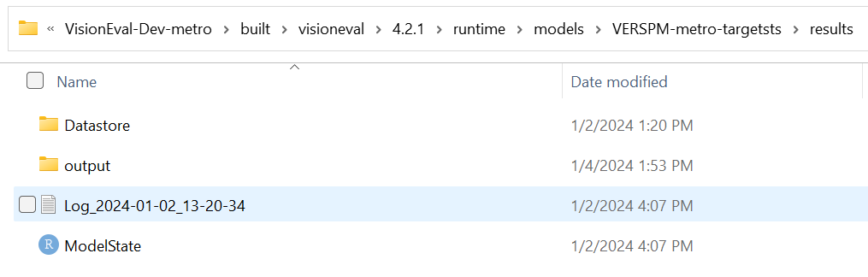
Step 6: Extract Model Results
Extract VE Model Run Results and Filter to the Target Rule Area
Once the model has finished running, use the built in VE export functions to export the model data as CSV outputs using the following code:
Results <- Model$results() (Note to user. That “Model” here is the name you called your model)
Results$export()
This will export the results as CSV files to the “results/output” folder. Depending on the number of years in the model, this process could take 15-20 minutes.
Export function can be set to dump into a variety of formats including directly into databases (sql, etc.)

Slide 15
Specific and Custom Packages

Slide 16
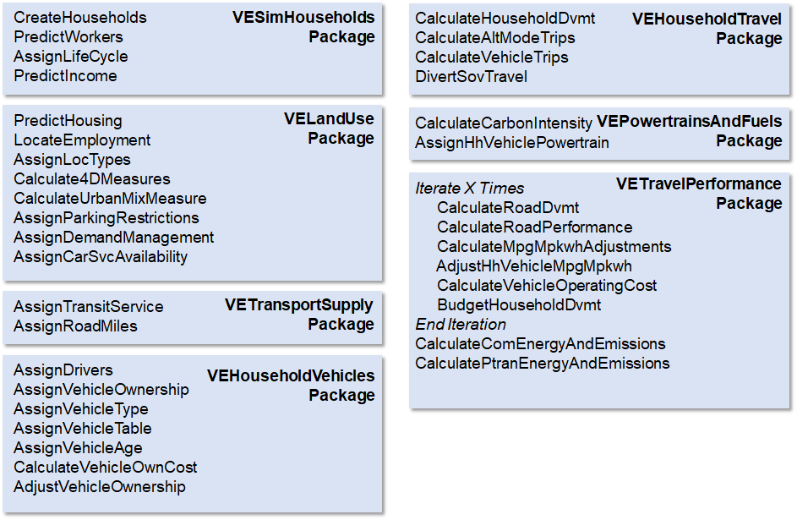
VE-RSPM Packages & Modules – Base FHWA

Slide 17
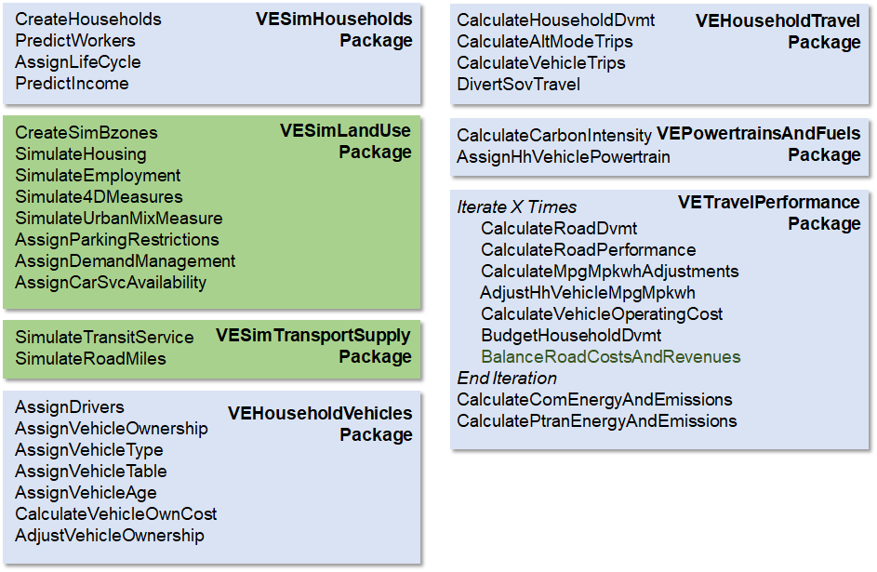
VE-State Packages & Modules – base FHWA

Slide 18
Travel Demand Package Evolution
Examples of evolution of packages in VE. However, highlights the need for naming, descriptions, and version control
VE Travel Demand
VE Travel DemandMM
VE Travel DemandMM
VE Travel DemandWFH
Default core travel demand package.
Available in any fork or repo
2009 NHTS designed package by Portland State
Comes in the FHWA VisionEval repos
2017 NHTS re-estimated package. Re-estimated the core travel model and the Alt Modes travel model.
Available on the OrScenPlanning VE_Extras Repo
https://github.com/ORScenPlg/ODOT_VE_Extras/tree/main/VETravelDemandMM
WFH package is a merge of the 2017 NHTS re-estimated package and Teleworking behaviors.
Introduced three occupation classes for propensity to Telework
Required commute distances
New parameters of occupation type in the core travel demand equations
Available on the OrScenPlanning VE_Extras repo: https://github.com/ORScenPlg/ODOT_VE_Extras/tree/main/VETravelDemandMM

Slide 19
Customized Packages
VEHouseholdVehiclesDL
VEHouseholdVehiclesIncCap
Specific Packages
VELandUseDL
VESimLandUseDL
This package has been used in the Oregon OTP and VE-State models in Oregon to better estimate the number of owned vehicles by households. Higher income households in the default model have a negative quadratic term that reduces ownership as income grows past a certain point.
The data from Oregon didn’t align with that – and instead, cap the income where that decline starts to occur.
VESimHouseholdsSKATS
VELandUseSKATS
The VESimHouseholdsSKATS is a unique name to align with the PUMS for the SKATS region that informs the synthetic population.
The VELandUseSKATS required code changes to look for the VESimHouseholdsSKATS.
VETravelPerformanceDL
The DL packages are associated with a range of updates that were made to account for Driverless Vehicles.
The packages that RSG created include several updates
- L3 highly connected vehicles
- L5 fully automated vehicles
New household models:
- propensity for sharing (reducing owned vehicles)
- propensity for L5 vehicle ownership
Features include:
- deadheading
- shared vs unshared price differential on car sharing
- changes in roadway capacity associated with different driving characteristics (both negative and positive on capacity)
- changes in travel consumed by households

